Slide 1
Hyper-parameter Selection
罗成

Slide 2
Package: hyperopt
Install package
# install package
[1]: !pip install hyperopt
# load package and test installation
[2]: import hyperopt
Important functions:
hyperopt.fmin
Minimize a function
hyperopt.hp
Define the support and distribution of a random variable
Remark:
Hyperopt is not gradient based
Hyperopt is Bayesian optimization
Two algorithms are included:
Random search
Tree-of-Parzen Estimators

Slide 3
A simple example
# import functions
[1]: from hyperopt import fmin, tpe, hp
# define objective function
[2]: def f(args):
...: x, y = args
...: return x ** 2 + y ** 2
# define scope of variables
[3]: space = [hp.uniform(‘x’, 0, 1), hp.uniform(‘y’, 0, 1)]
# minimize the objective function
[4]: best = fmin(f, space, algo = tpe.suggest, max_evals = 100)
# print result
[5]: print(best)
Remark:
The scope of variables are distributions
Objective function has only one argument
Result:
{'x': 0.0019039436699345158, 'y': 0.0007755093353038096}

Slide 4
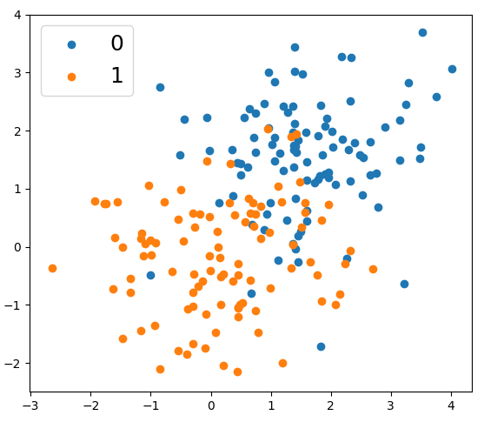
A more realistic example
# import packages
[1]: import numpy as np
[2]: import matplotlib.pyplot as plt
# construct data set
[3]: data = np.random.randint(200,2)
# plot data
[4]: plt.scatter(data[:100,0], data[:100,0])
[5]: plt.scatter(data[100:,0], data[100:,0])
# create labels
[6]: labels = np.array([0] * 100 + [1] * 100)

Slide 5
Use default parameters as baseline
# split training and validation data
[1]: idx = np.random.permutation(200)
[2]: xTrain = data[idx[:150]]
[3]: xVal = data[idx[150:]]
[4]: yTrain = labels[idx[:150]]
[5]: yVal = labels[idx[150:]]
# split training and validation data
[6]: rfc = lgb.LGBMClassifier()
[7]: model = rfc.fit(xTrain, yTrain)
[8]: yPred = model.predict_proba(xVal)
[9]: fpr, tpr, _ = roc_curve(yVal, yPred[:,1])
# split training and validation data
print(auc(fpr, tpr))
Remark:
Use lightgbm to classify the data points
Some default values are:
max_depth = -1
learning_rate = 0.1
num_leaves = 31
reg_alpha = 0.0
reg_lambda = 0.0
Result:
Auc for validation is: 0.891826923076923

Slide 6
Define objective function
# define objective function
[1]: def objective(args):
...: max_depth, learning_rate, num_leaves, reg_alpha, reg_lambda = args
...: classifier = lgb.LGBMClassifier(num_leaves = num_leaves,
...: max_depth = max_depth,
...: learning_rate = learning_rate,
...: reg_alpha = reg_alpha,
...: reg_lambda = reglambda)
...: model = classifier.fit(xTrain, yTrain)
...: pred = model.predict_proba(xVal)
...: fpr, tpr, _ = roc_curve(yVal, pred[:1])
...: return 1 – roc(fpr, tpr)
Remark: return (1 – roc) for minimizing

Slide 7
Scope and run
# define the distribution for hyper-parameters
[1]: space = [(2 + hp.randint(‘num_leaves’, 50)),
...: (2 + hp.randint(‘max_depth’, 50)),
...: hp.lognormal(‘learning_rate’, 0.1, 0.2),
...: hp.lognormal(‘reg_alpha’, 0.1, 0.2),
...: hp.lognormal(‘reg_lambda’, 0.1, 0.2)]
# find the optimal hyper-parameters
[2]: best = fmin(objective,
...: algo = tpe.suggest,
...: space,
...: max_evals = 500)
# print the hyper-parameters that minimize the objective
[3]: print(best)
Remark:
lgb requiments:
num_leaves > 1
max_depth > 1
Result:
The optimal values are:
max_depth = 8
learning_rate = 2.695533
num_leaves = 15
reg_alpha = 2.174686
reg_lambda = 1.202033
Auc: 0.9271

